Slide 1
Data structures and files
SCE

Slide 2
GROUP MEMBERS
ROLL NO. | NAME | GR NO
223060 | Sohan Shinde | 21911133
223064 | Swaleha Kittur | 21911155
223066 | Aakanksha Thokare | 21910700
223068 | Vatsal Arya | 21911193

Slide 3
Binary Search Tree
Binary Search tree can be defined as a class of binary trees, in which the nodes are arranged in a specific order. This is also called ordered binary tree.
Binary Search Tree (BST) is a tree in which all the nodes follow the below-mentioned properties −
The value of the key of the left sub-tree is less than the value of its parent (root) node's key.
The value of the key of the right sub-tree is greater than or equal to the value of its parent node's key.
This rule will be recursively applied to all the left and right sub-trees of the root.
i.e left_subtree (keys) < node (key) ≤ right_subtree (keys)
It is called a binary tree because each tree node has a maximum of two children.\
It is called a search tree because it can be used to search for the presence of a number in O(log(n)) time.

Slide 4
Time Complexity of operations in Binary Search Tree
Searching: For searching element 7, we have to traverse all elements (in order 1, 2, 3, 4, 5, 6, 7). Therefore, searching in binary search tree has worst case complexity of O(n). In general, time complexity is O(h) where h is height of BST.
Insertion: For inserting element 8, it must be inserted as right child of 7. Therefore, we need to traverse all elements (in order 1, 2, 3, 4, 5, 6, 7) to insert 8 which has worst case complexity of O(n). In general, time complexity is O(h).
Deletion: For deletion of element 7, we have to traverse all elements to find 7 (in order 1, 2, 3, 4, 5, 6, 7). Therefore, deletion in binary tree has worst case complexity of O(n). In general, time complexity is O(h).

Slide 5

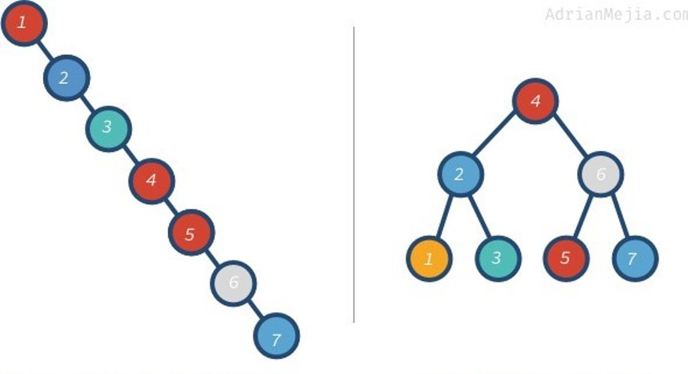
Skewed binary search tree – O(n)
Height balanced binary search tree – O(log n)

Slide 6
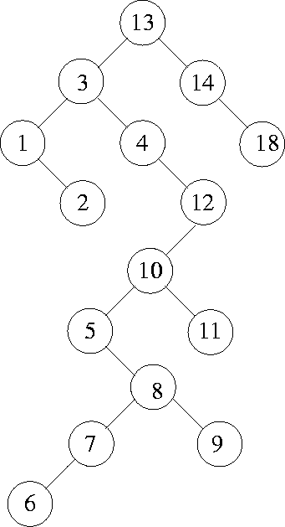
Example: 13, 3, 4, 12, 14, 10, 5, 1, 8, 2, 7, 9, 11, 6, 18

Slide 7
Problem Statement
In an attendance monitoring system, the unique integer ID number of every employee is noted whenever the employee enters the organization. First time an employee enters into the office, the corresponding id is set to 1. From then onwards, each time an employee leaves the office premises for tea break or lunch break, and enters back this id is incremented.

Slide 8
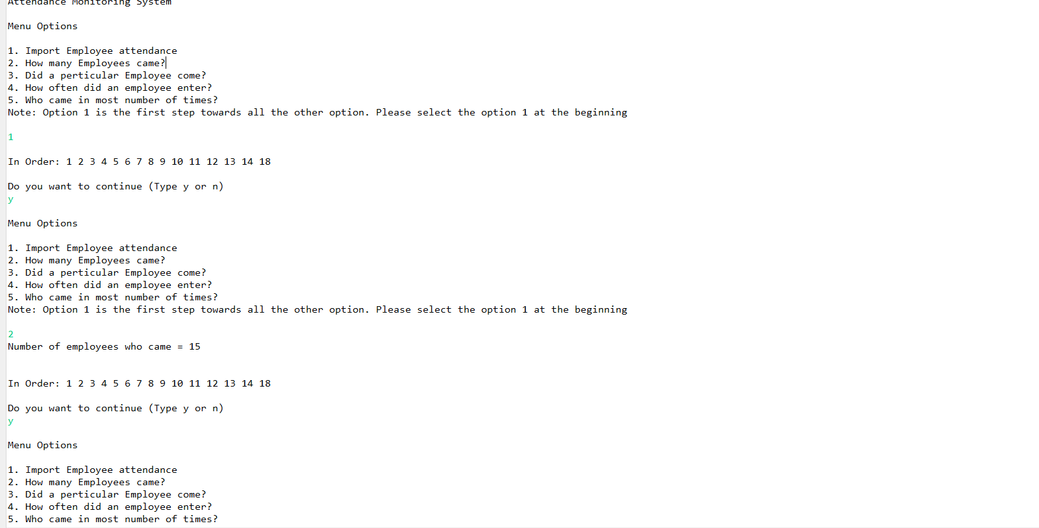
Output :

Slide 9
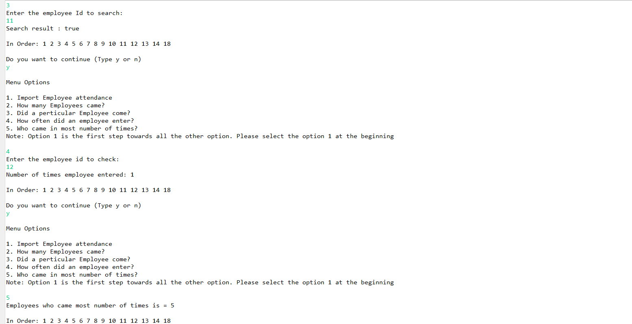
Output :

Slide 10
THANK YOU

